Slide 1
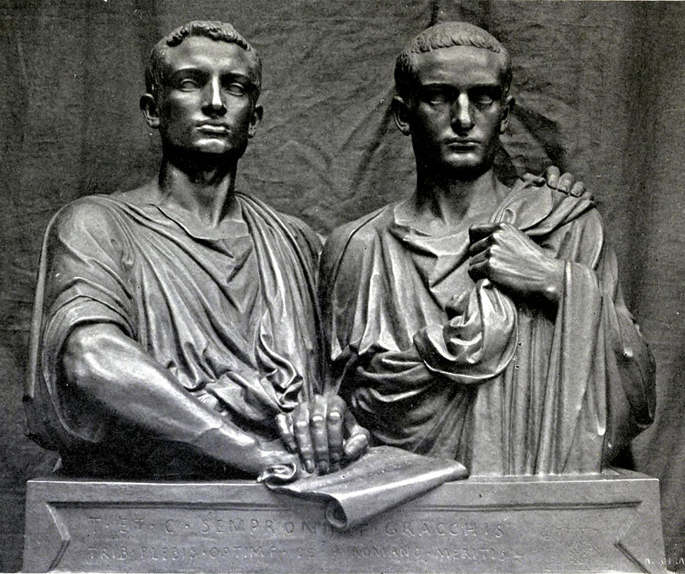
Doco Day!
GOAL/S: Review key P/E/I - historical context
Week 6, Lesson 1

Slide 2
Watch the following:
https://www.youtube.com/watch?v=PvPsUwL-2Lk&ab_channel=BanijayHistory
Rome The World's First Superpower: Tiberius | Ancient Rome Documentary | Reel Truth. History
Take notes on the following:
Key People
Key Events
Key Ideas

